Slide 1
LING 573 Project
Charlie Guo
Emma Bateman
John Dodson
qcg@uw.edu
ebateman@uw.edu
jrdodson@uw.edu

Slide 2

Overview
Baseline extractive system
Graph-banked sentence ranking
Entity grid information ordering
Sentence compression

Slide 3
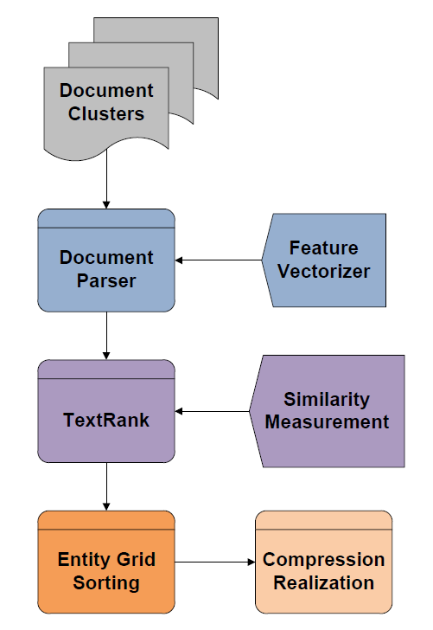
System Architecture

Slide 4
Approach

Slide 5
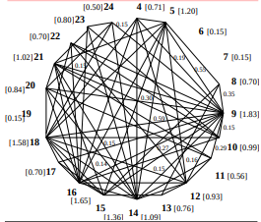
Content Selection
Sentence saliency estimated with TextRank
Sentences converted to unigram feature vectors
Ranked from highest to lowest relevance
Duplicates are removed
Sentences selected until word count is met

Slide 6
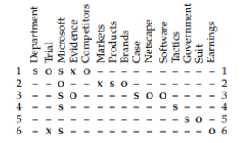
Information Ordering: Entity Grid
Based on Barzilay and Lapata (2008)
Find entities mentioned in summary
For each entity, sentence pair determine grammatical role if any
Assign weights: 1.0 for subject, 0.5 for object, 0.1 for none
Calculate weight for each entity over all candidate sentences
Pick highest weighted entity and select sentence with the highest weight for that entity
Repeat until all sentences are sorted

Slide 7
Information Ordering: Shortest Path
Generate bag-of-words feature vector for each sentence
Find cosine distances
Brute force search to generate shortest path
More salient endpoint chosen as starting point

Slide 8
Content Realization
Sentence compression
Named Entity simplification

Slide 9
Sentence Compression: Rule-based
Tree-based PP Removal
Obtain a syntax tree of a sentence
Identify PP and check removability
Realize sentence without PP
Example:
Senior Palestinian official Yasser Abed Rabbo denied on Tuesday reports saying that Palestinian leader Yasser Arafat has died in a French hospital.

Slide 10
Sentence Compression: Rule-based
Rule-based Datetime removal
Identify datetime entities
Flag entities as “Removed”
Identify preceding prepositions and flag
Realize
Example:
Senior Palestinian official Yasser Abed Rabbo denied on Tuesday reports saying that Palestinian leader Yasser Arafat has died in a French hospital.

Slide 11
Sentence Compression: Trained Model
Training Data
BBC newswire sentences with hand-written compressions
Originally used in Clarke and Lapata (2008)
Downloaded from: jamesclarke.net/research/resources
MaxEnt model
1000 training sentences parsed
Each node of tree labeled “keep” (1) or “delete” (0)
Training features such as: POS, sister node POS, depth, conatins stopwords, contains punctuation,

Slide 12
Sentence Compression: Trained Model
Training Data
BBC newswire sentences with hand-written compressions
Originally used in Clarke and Lapata (2008)
Downloaded from: jamesclarke.net/research/resources
MaxEnt model
1000 training sentences parsed
Each node of tree labeled “keep” (1) or “delete” (0)
Binary classifier trained with sklearn Logistic Regression model

Slide 13
Sentence Compression: Trained Model
Training Features
POS tag
Sister node POS tag
Within first three words?
Within last three words?
Contains word with >10 letters?
Contains uppercase?
Contains negation?
Contain stopwords?
Parenthetical?
Lead adverbial?
Lead preposition?
Relative clause?
Is root node?

Slide 14
Sentence Compression: Trained Model
Beam Search
Keep/delete labels chosen using MaxEnt classifier and beam search
Recursive search
For each node, run beam search on each child node. Calculate probabilities for each resulting combination, plus probability of deleting current subtree. Return N most likely candidates.
At leaf nodes, return [[0], [1]]

Slide 15
Sentence Compression Tools
NLTK
Stanford parser
Scikit learn
Clarke and Lapata (2008) compression data

Slide 16
Name Simplification
Examples
Senior Palestinian official Yasser Abed Rabbo denied on Tuesday reports saying that Palestinian leader Yasser Arafat has died in a French hospital.
As Arafat had struggled for life, there has been wild guess as to where he might be buried and where to hold the funeral service.
Sunday night, the French foreign minister, Michel Barnier, told LCI television that Arafat was alive but that his circumstances were complicated.
Palestinian leader Yasser Arafat would be buried at his headquarters in the West Bank town of Ramallah, well-informed Palestinian sources said Tuesday.

Slide 17
Name Simplification
Algorithm (on ordered sentences)
Create a dictionary mapping full name to last name
For each sentence, identify PERSON entities
If a PERSON entity is a full name, replace it with last name
Otherwise add this full name to the dictionary.

Slide 18
Name Simplification
Tools
Spacy
Python 3.6+

Slide 19
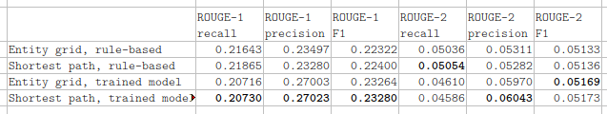
Results: Dev test

Slide 20
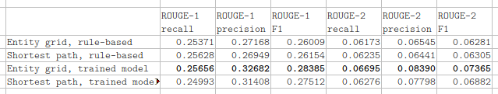
Results: Eval test

Slide 21
Related Readings
Rada Mihalcea and Paul Tarau, TextRank: Bringing Order into Texts, Proceedings of the 2004 Conference
on Empirical Methods in Natural Language Processing,
2004.
Regina Barzilay and Mirella Lapata, Modeling Local
Coherence: An Entity-Based Approach Computational
Linguistics, 2008
Christopher Manning, Mihai Surdeanu, John Bauer,
Jenny Finkel, Steven Bethard, and David McClosky,
The Stanford CoreNLP Natural Language Processing
Toolkit, Proceedings of 52nd Annual Meeting of
the Association for Computational Linguistics: System
Demonstrations
James Clarke and Mirella Lapata, 2008. Global Inferece for Sentence Compression: An Integer Linear Programming Approach. In Journal of Artificial Intelligence Research, vol 31, pages 399-429.
Lu Wang et al. A Sentence Compression Based Framework to Query-Focused Multi-Document Summarization. Proceedings of the 51st Annual Meeting of the Association for Computational Linguistics, pages 1384-1394. 2013

Slide 22
Thank you.

